Slide 1
Discussion on WSL’s NPDES Permit to dispose of leachate into the Monongahela River & Speers Run

Slide 2
Welcome & Who we are
About Protect PT: Protect Penn-Trafford is a citizen's group working to ensure the safety, security, and quality of life from the effects of unconventional gas development in Penn-Trafford and surrounding communities in Westmoreland and Allegheny Counties. Learn more at www.protectpt.org.
About Three Rivers Waterkeeper (3RWK): is a non-profit organization with a mission to protect and restore the Allegheny, Monongahela, and Ohio Rivers and their respective watersheds in SW Pennsylvania. 3RWK is both a scientific and legal advocate for the community, working to ensure our three rivers are protected and safe to drink, fish, swim and enjoy. Learn more at ​www.3RWK.org.
Physicians for Social Responsibility is an advocate organization dedicated to addressing the environmental and public health challenges facing our communities. We work to advance policies that protect our natural resources, promote sustainable development, and ensure the health and safety of all Pennsylvanians.
Additional Support Provided by:

Slide 3
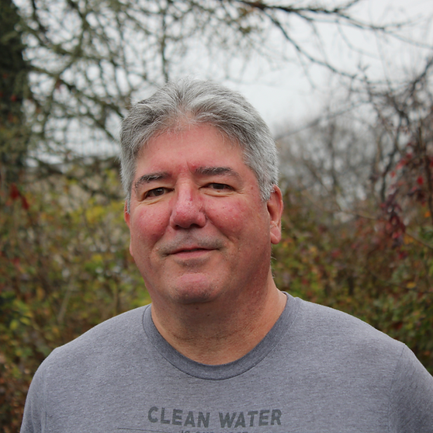
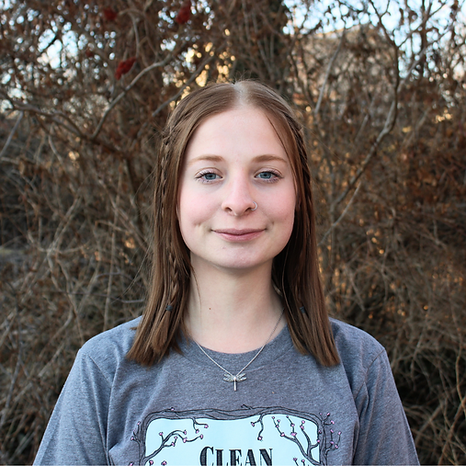
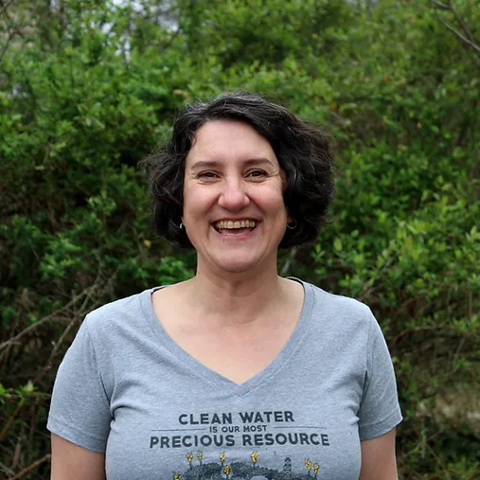
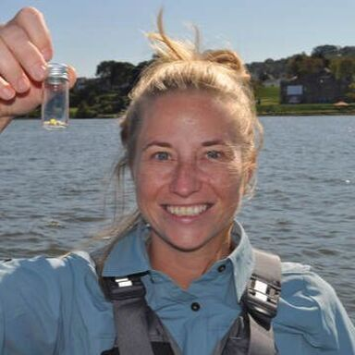
Who We Are
Gillian Graber,
Executive Director
Jim Cirilano,
Community Advocate
Dylan Basescu,
Staff Attorney
Sara Majorsky,
Community Organizer
Yvonne Sorovacu,
Environmental Scientist
Heather Hulton VanTassel, Executive Director
Matthew Shorraw,
Policy and Program Coordinator, PSR PA

Slide 4
Agenda
Landfills & Fracking Waste
(PPT)
2. Clean Water Act & Water Discharge Permits (3RWK)
3. Historical Compliance & known issues (3RWK)
4. New Outfall & Missing Requirements (3RWK)
5. Legal Right to Comment
(PPT)
6. Public and Written comment support (PPT)
7. Monitoring App
8. Questions?

Slide 5
Westmoreland Sanitary Landfill
WSL (Westmoreland Sanitary Landfill) has been trying to dispose of radioactive, toxic leachate for over a decade
WSL has multiple consent orders for violating PA laws for handling leachate
Consent Order: Department of Environmental Protection (DEP) says the WSL broke the law, WSL agrees and promises to take steps to stop
WSL tried and failed to obtain a permit for a Leachate Evaporator in 2024
WSL is now proposing an additional outfall (wastewater discharge point), outfall 4, to dump contaminated water into the Mon River

Slide 6
Landfill Leachate
WSL generates leachate containing chlorides and radiation from fracking waste
WSL leachate was rejected by the Belle Vernon Treatment Works, is too expensive to truck off site to treatment facilities long term, and can’t be safely evaporated into the air
WSL’s latest attempt to solve its leachate problem: on-site treatment and discharge into the Monongahela River
Notes:
Here's a more detailed breakdown of the chemicals commonly found in fracking wastewater:
Salts and Metals:
Salts: Chloride, bromide, sulfate, and sodium are common anions and cations found in produced water.
Metals: Magnesium, calcium, strontium, barium, manganese, iron, aluminum, arsenic, and selenium can be present.
Radioactive Materials: Radium, barium, and radon are naturally occurring radioactive particles that may be mobilized from the shale layer and found in the wastewater.
Man-made Chemicals:
Surfactants, Biocides, Corrosion Inhibitors, and Friction Reducers: These are used in the fracking process and can remain in the wastewater.
Organic Compounds: Researchers have identified a wide range of organic compounds, including pesticides, irritants, and carcinogens.
Specific examples:
Benzene, Toluene, 2-butoxyethanol: These are known to be highly toxic and cancer-causing.
Hydrochloric acid: A federally listed hazardous air pollutant.
Glutaraldehyde: A common biocide.
Naphthalene: A known carcinogen.
Heavy aromatic naphtha: A neurotoxin known to cause cancer in lab animals.
2-BE: A glycol ether surfactant.
Other Contaminants:
Methane: Can contaminate drinking water.
Naturally occurring radioactive material (NORM): Can be mobilized from the shale layer and found in the wastewater.
Polycyclic aromatic hydrocarbons (PAHs):
1,4-dioxane:
Pyridine:
Here's a more detailed breakdown of common contaminants found in landfill leachate:
1. Heavy Metals:
Examples: Lead, mercury, cadmium, chromium, nickel, zinc, and copper.
Source: Industrial waste, paints, batteries, and other sources.
Concern: Highly toxic, even in trace amounts, and can accumulate in the environment and cause harm to human and animal health.
2. Organic Compounds:
Examples: Pesticides, solvents, pharmaceuticals, plasticizers, and other chemicals.
Source: Municipal waste, industrial waste, and household products.
Concern: Can contaminate water sources and cause health problems.
3. Pathogens:
Examples: Bacteria, viruses, and parasites.

Slide 7
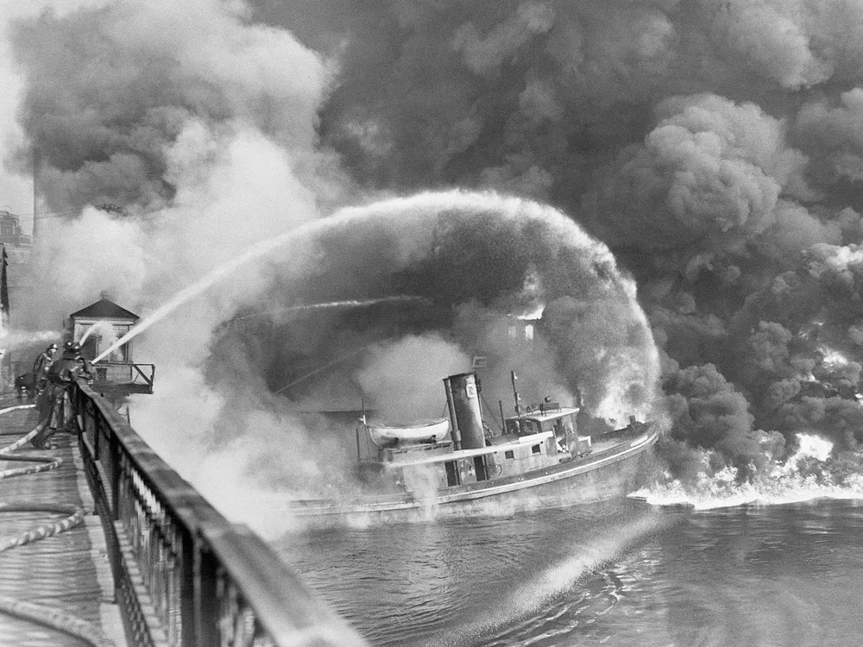
Clean Water Act (CWA)
1972 Federal Legislation aimed at drinkable, fishable, swimmable waters
CWA Regulates all discharges into the Waters of the United States
Regulated through National Pollutant Discharge Elimination System (NPDES)
Enforced by the US Environmental Protection Agency
Delegated oversight to the PA Department of Environmental Protection

Slide 8
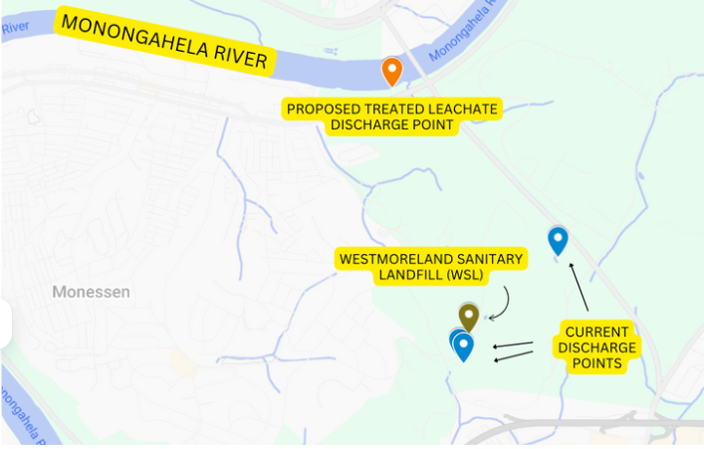
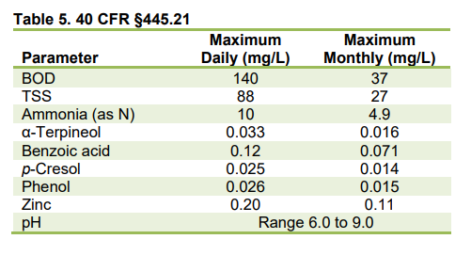
WSL NPDES PERMIT
Outfalls 1 - 3: Current discharge points
Monitor & Report Only
Outfall 4: NEW
Monitor & Report only
PFOA, PFOS, HFPO-DA, PFBS (PFAS contaminants)

Slide 9
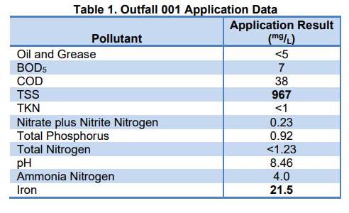
WSL NPDES PERMIT
Outfall 1: Reported Grab Samples
Outfall 4: NEW Limits

Slide 10
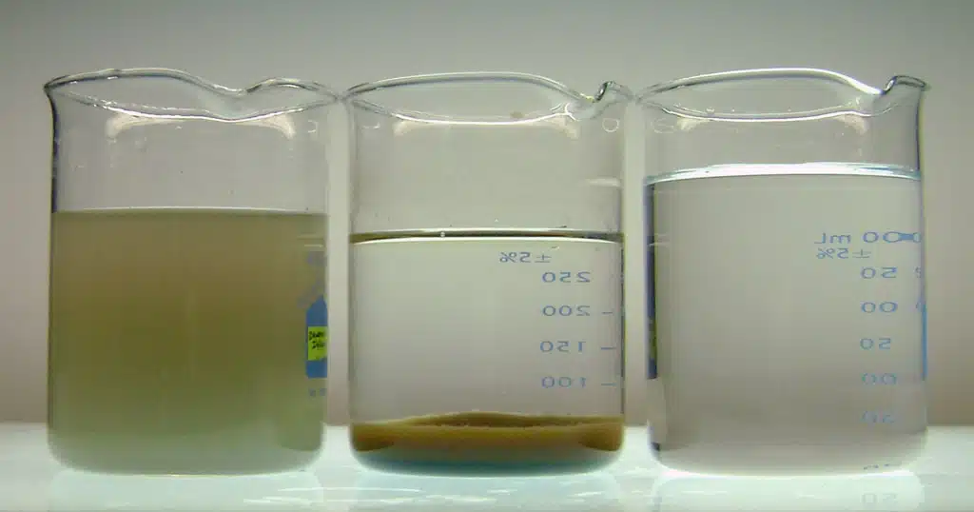
Total Suspended Solids (TSS)
Total Suspended Solids
TSS includes particles like silt, clay, algae, and other organic matter
TSS can also include inorganic substances like minerals, salts, and metals
TSS is harmful in excess and is listed as a conventional pollutant in the Clean Water Act
Higher concentrations of TSS can indicate turbidity, reduced plant growth, and decreased penetration of sunlight into the water

Slide 11
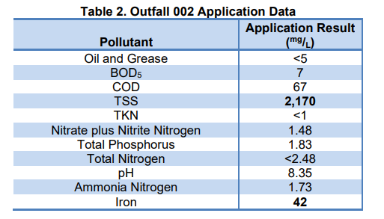
WSL NPDES PERMIT
Outfall 2: Reported Grab Samples
Outfall 4: NEW Limits

Slide 12
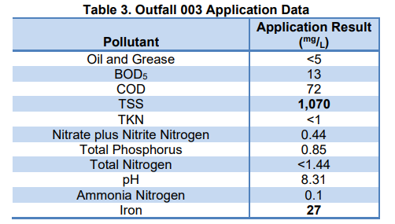
WSL NPDES PERMIT
Outfall 3: Reported Grab Samples
Outfall 4: NEW Limits

Slide 13
WSL NPDES PERMIT
Self reporting data for their current outfalls 1- 3 (only 2024 data available)
Contaminant Self Reported | Highest Reported | Units | NPDES Stormwater Benchmark
Ammonia-Nitrogen | < 0.10 | mg/L | n/a
Chemical Oxygen Demand (COD) | < 10 | mg/L | 120
Iron, Total | 42 | mg/L | 1
pH | 8.38 | S.U. | 6 to 9
Total Nitrogen | < 2.48 | mg/L | 3
Total Phosphorus | < 0.85 | mg/L | n/a
Total Suspended Solids | 2160 | mg/L | 100

Slide 14
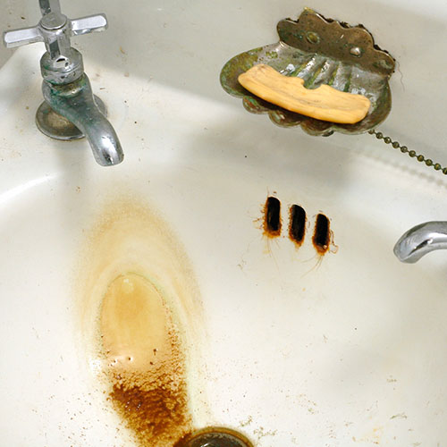
Iron
Not hazardous to human health but has negative impacts in excess
Dissolved ferrous iron gives water a disagreeable metallic taste
Concentrations of iron as low as 0.3 mg/L will leave reddish brown stains on fixtures, tableware and laundry that are very hard to remove
When iron exists along with certain kinds of bacteria, a smelly biofilm can form
Excess iron in water can negatively impact aquatic life by forming harmful precipitates that clog gills, interfere with respiration, and damage eggs, while also affecting water quality and ecosystem health.

Slide 15
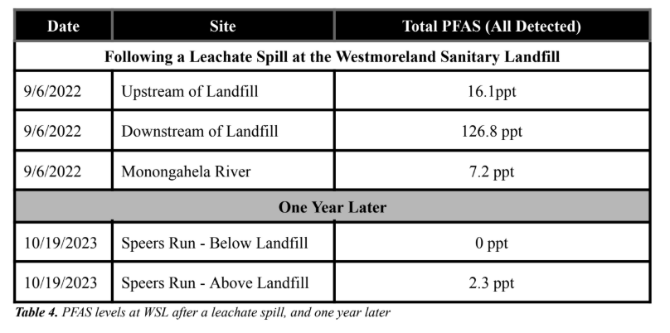
PFAS
PFAS, or Per- and Polyfluoroalkyl Substances are a group of manufactured chemicals
“Forever Chemicals”
Can cause harmful health effects
WSL released leachate into the environment on many occasions between August 24th, 2022 and February 28th, 2023
3RWK detected 16 different PFAS contaminants below the landfill
Only three of these PFAS would be detected with the sampling required in their permit.

Slide 16
WSL NPDES PERMIT
Outfall 4: NEW Limits
PFAS are only monitor & Report
Iron is not listed and is a known, self-reported issue
MISSING! (other known fracking waste & landfill leachate issues)
Radiologicals, such as radium
Heavy Metals, such as Lead, mercury, cadmium, chromium, nickel, zinc, and copper
Common harmful man-made Organics, such as benzene and toluene

Slide 17
WSL NPDES PERMIT ISSUES
Outfalls 1-3 should have PFAS, TSS & Iron limits!
Outfall 4 should have limits on the following additional items
16 PFAS contaminants documented downstream
Radiologicals, such as radium
Heavy Metals, such as Lead, mercury, cadmium, chromium, nickel, zinc, and copper
Common harmful man-made Organics, such as benzene and toluene

Slide 18
Legal Right to Comment
DEP may only issue a NPDES permit if the permit application meets all state and federal requirements, and the permit meets state and federal water quality laws. 25 Pa. Code § 92a.36
Written public comment must be accepted for 30 days after a draft permit is published, and up to 45 days at the DEP’s discretion. A hearing is required if there is “significant public interest” in a permit application. 25 Pa. Code § 92a.82(d)
Comments must be considered by the Department in its decision on whether to issue the permit

Slide 19
Talking Points for Public Comment
WSL has an abysmal compliance history
4 ongoing consent orders
Multiple related to failure to properly handle leachate
27 violations since 2020
Radioactive contamination only two days of river flow away from Pittsburgh
WSL created this problem by using fracking waste as landfill ground cover in the first place, this was avoidable

Slide 20
Talking Points for Public Comment (cont.)
WSL’s “treated leachate” exceeds acceptable permit standards for multiple pollutants
Inadequate long term monitoring standards for radioactive materials and PF substances
Monongahela River in the area is already impaired for Sediment, Metals, Low Oxygen, PCBs, and Abnormal Flow even before adding more pollution
7 conditions where the EPA must always review a NPDES permit: 40 CFR 123.24(d)
Discharges that may flow into other states: 40 CFR 123.24(d)(2)

Slide 21
Comment Period
Oral comments
On March 20, 2025
Rostraver CFD Social Hall, 1100 Fells Church Rd, Rostraver, PA 15012
6 PM to 8:30 PM
To register contact Emily Green, Southwest Regional Environmental Justice Coordinator, by email at emgreen@pa.gov or by calling 412-442-4042 at least 24 hours before the hearing.
Written comments
by April 3rd, 2025
Email to: RA-EPNPDES@pa.gov
Mail to: DEP Southwest Regional Office ℅ Clean Water Program
400 Waterfront Drive, Pittsburgh, PA 15222
Can be longer than oral comments
Notes:
Consider writing your own public comment to express your concerns on this issue by April 3rd and send to the DEP Southwest Regional Office c/o Clean Water Program, 400 Waterfront Drive, Pittsburgh, PA 15222 or via email RA-EPNPDES_SWRO@pa.gov.

Slide 22
Oral Comment Guidelines
Three minute maximum
Around 450 words, or two single-space pages of text
Focus your comment on the draft permit and the data about it
DEP is highly concerned with facts and figures
Link personal experiences (sights, smells, ailments) to specific chemical contamination due to leachate

Slide 23
Document Complaints
Protect PT Mobile Reporting App
Report.protectpt.org
Easy to use on any device
No need to download from the App Store: it’s a website!
Our app guides users through the process of creating a report that connects the dots from real-life impacts to environmental harms and next steps on reporting to agencies and medical professionals
You can upload pictures and videos for easy tracking

Slide 24
THANK YOU!
Contact Us
Protect PT www.protectpt.org
gillian@protectpt.org,
james@protectpt.org,
dylan@protectpt.org,
sara@protectpt.org,
yvonne@protectpt.org
Three Rivers Waterkeeper www.3RWK.org
Heather@hreeRiversWaterkeeper.org,
Physicians for Social Responsibility PA www.psrpa.org
mathew@psrpa.org

